Slide 1
Cellular Wireless Networks
Chapter 6

Slide 2
Cellular Network Organization
Use multiple low-power transmitters (100 W or less)
Areas divided into cells
  Each served by its own antenna
  Served by base station consisting of transmitter, receiver, and control unit
  Band of frequencies allocated
  Cells set up such that antennas of all neighbors are equidistant (hexagonal pattern)

Slide 3
Frequency Reuse
Adjacent cells assigned different frequencies to avoid interference or crosstalk
Objective is to reuse frequency in nearby cells
  10 to 50 frequencies assigned to each cell
  Transmission power controlled to limit power at that frequency escaping to adjacent cells
  The issue is to determine how many cells must intervene between two cells using the same frequency

Slide 4
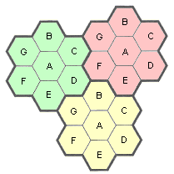
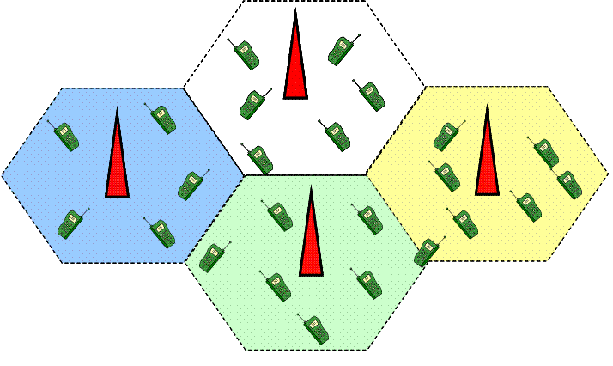
Cellular Network and Frequency Reuse
Cellular systems
Frequency reuse

Slide 5
Approaches to Cope with Increasing Capacity
Adding new channels
Frequency borrowing – frequencies are taken from adjacent cells by congested cells
Cell splitting – cells in areas of high usage can be split into smaller cells
Cell sectoring – cells are divided into a number of wedge-shaped sectors, each with their own set of channels
Microcells – antennas move to buildings, hills, and lamp posts

Slide 6
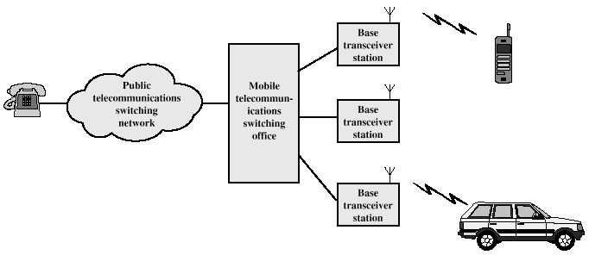
Cellular System Overview

Slide 7
Cellular Systems Terms
Base Station (BS) – includes an antenna, a controller, and a number of receivers
Mobile telecommunications switching office (MTSO) – connects calls between mobile units
Two types of channels available between mobile unit and BS
  Control channels – used to exchange information having to do with setting up and maintaining calls
  Traffic channels – carry voice or data connection between users

Slide 8
Steps in an MTSO Controlled Call between Mobile Users
Mobile unit initialization
  When mobile unit turns on, it scans and selects the strongest setup control channel
Mobile-originated call
  Mobile originates a call by sending the number of the called unit on the setup channel
Paging
  MTSO sends a paging message to certain BSs depending on the called mobile unit number
Call accepted
  The called mobile unit recognizes its number on the setup channel
Ongoing call
Handoff
  If a mobile unit movies out of one cell and into another cell during a connection, the traffic channel has to change to the new cell.

Slide 9
Additional Functions in an MTSO Controlled Call
Call blocking
  If all the traffic channels assigned are busy
Call termination
Call drop
  If the BS cannot maintain the minimum required signal strength for a certain period of time
Calls to/from fixed and remote mobile subscriber

Slide 10
Mobile Radio Propagation Effects
Signal strength
  Must be strong enough between base station and mobile unit to maintain signal quality at the receiver
  Must not be so strong as to create too much cochannel interference with channels in another cell using the same frequency band
Fading
  Signal propagation effects may disrupt the signal and cause errors

Slide 11
Power Control
Design issues making it desirable to include dynamic power control in a cellular system
  Received power must be sufficiently above the background noise for effective communication
  Desirable to minimize power in the transmitted signal from the mobile
    Reduce cochannel interference, alleviate health concerns, save battery power
  In SS systems using CDMA, it’s desirable to equalize the received power level from all mobile units at the BS

Slide 12
Types of Power Control
Open-loop power control
  Depends solely on mobile unit
  No feedback from BS
  Not as accurate as closed-loop, but can react quicker to fluctuations in signal strength
Closed-loop power control
  Adjusts signal strength in reverse channel based on metric of performance
  BS makes power adjustment decision and communicates to mobile on control channel

Slide 13
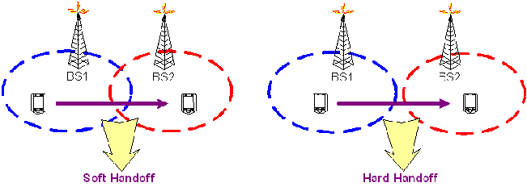
Types of Handoff
Hard handoff
  Mobile disconnects from one cell and then connects another cell
Soft hardoff
  Mobile maintains connection to both cells simultaneously during the transition

Slide 14
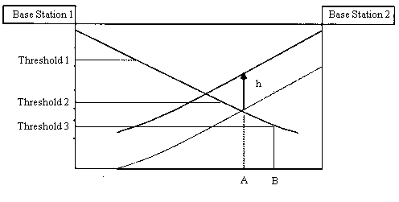
Handoff Strategies Used to Determine Instant of Handoff
Relative signal strength
  The mobile unit is handed off from BS A to BS B when the signal strength at B first exceeds that at A.
Relative signal strength with threshold
  Handoff occurs if the signal at the current BS is sufficiently week (less than a threshold) and the other signal is stronger of the two.
Relative signal strength with hysteresis
  Handoff occurs if the new BS is sufficiently stronger (by a margin h)

Slide 15
First-Generation Analog
Advanced Mobile Phone Service (AMPS)
  In North America, two 25-MHz bands allocated to AMPS
    One for transmission from base to mobile unit
    One for transmission from mobile unit to base
  Each band split in two to encourage competition
  Frequency reuse exploited

Slide 16
AMPS Operation
Subscriber initiates call by keying in phone number and presses send key
MTSO verifies number and authorizes user
MTSO issues message to user’s cell phone indicating send and receive traffic channels
MTSO sends ringing signal to called party
Party answers; MTSO establishes circuit and initiates billing information
Either party hangs up; MTSO releases circuit, frees channels, completes billing

Slide 17
Differences Between First and Second Generation Systems
Digital traffic channels – first-generation systems are almost purely analog; second-generation systems are digital
Encryption – all second generation systems provide encryption to prevent eavesdropping
Error detection and correction – second-generation digital traffic allows for detection and correction, giving clear voice reception
Channel access – second-generation systems allow channels to be dynamically shared by a number of users

Slide 18
GSM
The most widely used second-generation TDMA scheme
25 MHz for base transmission (935-960MHz)
25 MHz for mobile transmission (890-915MHz)
The spectrum is divided into 200kHz-wide frequency bands, each of which provides 8 logical channels.

Slide 19
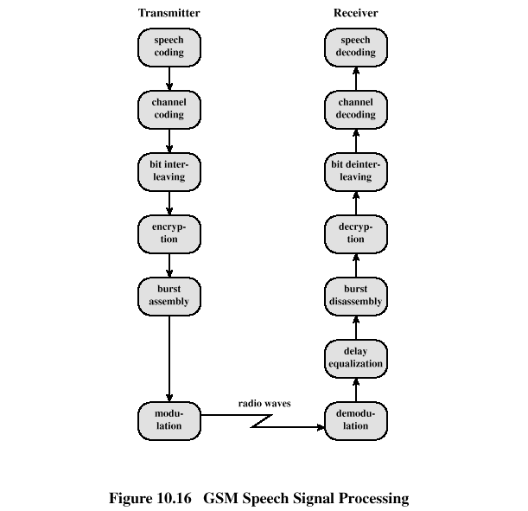
GSM Speech Signal Processing

Slide 20
Mobile Wireless TDMA Design Considerations
Number of logical channels (number of time slots in TDMA frame): 8
Maximum cell radius (R): 35 km
Frequency: region around 900 MHz
Maximum vehicle speed (V_{m}):250 km/hr
Maximum coding delay: approx. 20 ms
Maximum delay spread (Δ_{m}): 10 μs
Bandwidth: Not to exceed 200 kHz (25 kHz per channel)

Slide 21
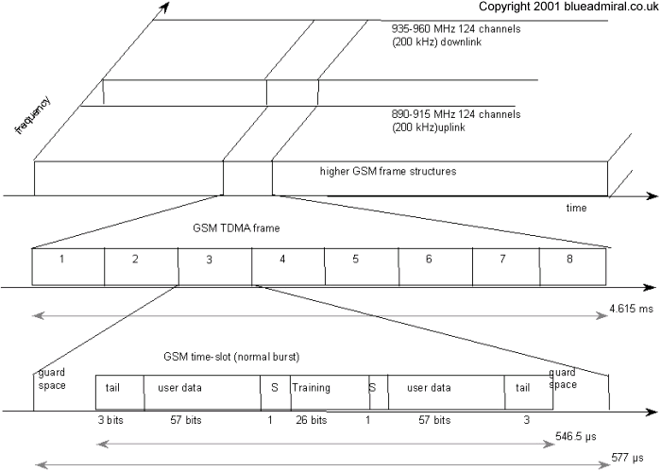
GSM frame structure

Slide 22
TDMA Format – Time Slot Fields
Trail bits – allow synchronization of transmissions from mobile units
Encrypted bits – encrypted data
Stealing bit - indicates whether block contains data or is "stolen"
Training sequence – used to adapt parameters of receiver to the current path propagation characteristics
  Strongest signal selected in case of multipath propagation
Guard bits – used to avoid overlapping with other bursts

Slide 23
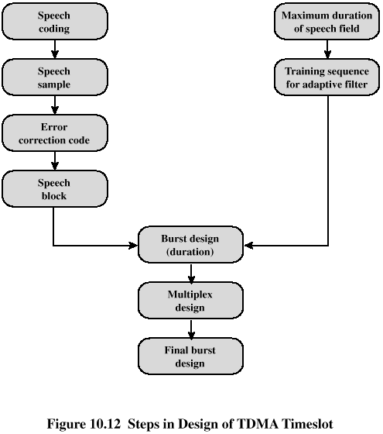
Steps in Design of TDMA Timeslot

Slide 24
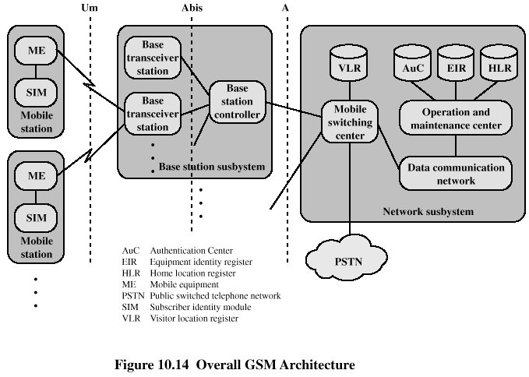
GSM Network Architecture

Slide 25
Mobile Station
Mobile station communicates across Um interface (air interface) with base station transceiver in same cell as mobile unit
Mobile equipment (ME) – physical terminal, such as a telephone or PCS
  ME includes radio transceiver, digital signal processors and subscriber identity module (SIM)
GSM subscriber units are generic until SIM is inserted
  SIMs roam, not necessarily the subscriber devices

Slide 26
Base Station Subsystem (BSS)
BSS consists of base station controller and one or more base transceiver stations (BTS)
Each BTS defines a single cell
  Includes radio antenna, radio transceiver and a link to a base station controller (BSC)
BSC reserves radio frequencies, manages handoff of mobile unit from one cell to another within BSS, and controls paging

Slide 27
Network Subsystem (NS)
NS provides link between cellular network and public switched telecommunications networks
  Controls handoffs between cells in different BSSs
  Authenticates users and validates accounts
  Enables worldwide roaming of mobile users
Central element of NS is the mobile switching center (MSC)

Slide 28
Mobile Switching Center (MSC) Databases
Home location register (HLR) database – stores information about each subscriber that belongs to it
Visitor location register (VLR) database – maintains information about subscribers currently physically in the region
Authentication center database (AuC) – used for authentication activities, holds encryption keys
Equipment identity register database (EIR) – keeps track of the type of equipment that exists at the mobile station

Slide 29
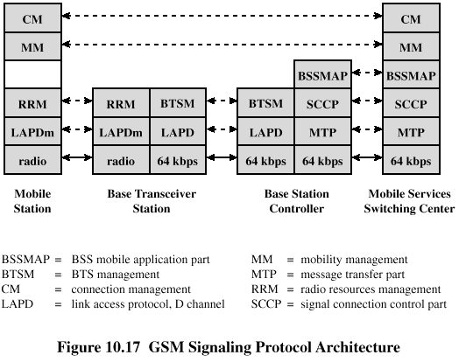
GSM Signaling Protocol Architecture

Slide 30
Functions Provided by Protocols
Protocols above the link layer of the GSM signaling protocol architecture provide specific functions:
  Radio resource management
    Controls setup, maintenance, and termination of radio channels
  Mobility management
    Location updating and registration procedures
  Connection management
  Mobile application part (MAP)
    Handles most of the signaling between different entities in the fixed part of the network, such as between HLR and VLR
  BTS management

Slide 31
Advantages of CDMA Cellular
Frequency diversity – frequency-dependent transmission impairments have less effect on signal
Multipath resistance – chipping codes used for CDMA exhibit low cross correlation and low autocorrelation
Privacy – privacy is inherent since spread spectrum is obtained by use of noise-like signals
Graceful degradation – system only gradually degrades as more users access the system

Slide 32
Drawbacks of CDMA Cellular
Self-jamming – arriving transmissions from multiple users not aligned on chip boundaries unless users are perfectly synchronized
Near-far problem – signals closer to the receiver are received with less attenuation than signals farther away
Soft handoff – requires that the mobile acquires the new cell before it relinquishes the old; this is more complex than hard handoff used in FDMA and TDMA schemes

Slide 33
IS-95
The most widely used second-generation CDMA scheme
IS-95 forward link (base transmission) 869MHz-894MHz
IS-96 reverse link (mobile transmission) 824MHz-849MHz
Frequency band is 1.25-MHz wide

Slide 34
IS-95
Forward Link
PN Generator
Walsh Code Generator
I-Channel Pilot PN Sequence
2^15-1
Specifies Forward Channel Id (0-63)
One of 64 possible
Power Control Bit
1.2288Mcps
Audio Compressor
Data to I channel of QPSK RF modulator
Convolutional Encoder
Block Interleaver.
Output data Rate:
9600 bps
4800 bps
2400 bps
1200 bps
Data Scrambling
MUX
1.2288Mcps
R=1/2
K=9
19.2kbps
24x16 array = 384 bits
1.2288Mbps
19.2kbps
19.2kbps
Data to Q channel of QPSK RF modulator
4bits @ 800Hz = 3200bps
Long Code Generator
Decimator
Decimator
1.2288Mcps
2^14-1 Permutations
(14 bit maximum length shift register)
L=64
(takes every 64th bit)
L=6
(takes every 6th bit)
Q-Channel Pilot PN Sequence
2^15-1
1.2288 Mcbs
19.2kbps
PN Generator

Slide 35
Types of Channels Supported by Forward Link
Pilot (channel 0) - allows the mobile unit to acquire timing information, provides phase reference and provides means for signal strength comparison
Synchronization (channel 32) - used by mobile station to obtain identification information about cellular system
Paging (channels 1 to 7) - contain messages for one or more mobile stations
Traffic (channels 8 to 31 and 33 to 63) – the forward channel supports 55 traffic channels

Slide 36
Forward Traffic Channel Processing Steps
Speech is encoded at a rate of 8550 bps
Additional bits added for error detection
Data transmitted in 2-ms blocks with forward error correction provided by a convolutional encoder
Data interleaved in blocks to reduce effects of errors
Data bits are scrambled, serving as a privacy mask

Slide 37
Forward Traffic Channel Processing Steps (cont.)
Power control information inserted into traffic channel
DS-SS function spreads the 19.2 kbps to a rate of 1.2288 Mbps using one row of 64 x 64 Walsh matrix
Digital bit stream modulated onto the carrier using QPSK modulation scheme

Slide 38
ITU’s View of Third-Generation (3G) Capabilities
Voice quality comparable to the public switched telephone network
144 kbps data rate available to users in high-speed motor vehicles over large areas
384 kbps available to pedestrians standing or moving slowly over small areas
Support for 2.048 Mbps for office use
Symmetrical / asymmetrical data transmission rates
Support for both packet switched and circuit switched data services

Slide 39
ITU’s View of Third-Generation Capabilities
An adaptive interface to the Internet to reflect efficiently the common asymmetry between inbound and outbound traffic
More efficient use of the available spectrum in general
Support for a wide variety of mobile equipment
Flexibility to allow the introduction of new services and technologies

Slide 40
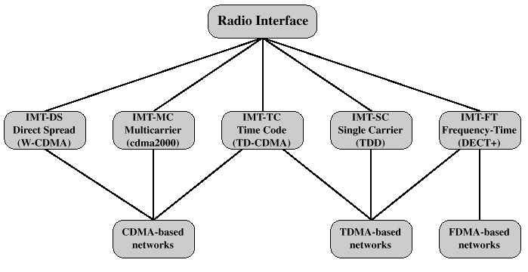
IMT-2000 (3G) Interfaces
Standardization efforts: 3GPP, 3GPP2 -- partnership/collaboration between groups of telecommunications associations

Slide 41
CDMA Design Considerations
Bandwidth – limit channel usage to 5 MHz
Chip rate – depends on desired data rate, need for error control, and bandwidth limitations; 3 Mcps or more is reasonable
Multirate – advantage is that the system can flexibly support multiple simultaneous applications from a given user and can efficiently use available capacity by only providing the capacity required for each service

Slide 42
Fourth-Generation (4G) Capabilities
A spectrally efficient system
Data rate of 100 Mbit/s for access in a moving car and 1Gbit/s for stationary users
Seamless connectivity and global roaming across multiple networks
High quality of service for multimedia support
Interoperability with existing wireless standards
All IP, packet-switched, networks

Slide 43
Fourth-Generation (4G) technologies
Based on orthogonal FDMA (OFDMA) and interleaved FDMA (IFDMA) are considered respectively for forward link and reverse link.
64-QAM modulation scheme
Multiple-input-multiple-output (MIMO) and multiuser MIMO technology
Standard: LTE (Long Term Evolution), supports scalable bandwidth -- 1.4 MHz, 3 MHz, 5 MHz, 10 MHz, 15 MHz and 20 MHz

Slide 44
Fourth-Generation (4G) Applications
At rate of 15-30 Mbit/s, 4G can provide high-definition TV.
At rate of 100 Mbit/s, the content of a DVD-5 can be downloaded within about 5 minutes

